Slide 1


Slide 2
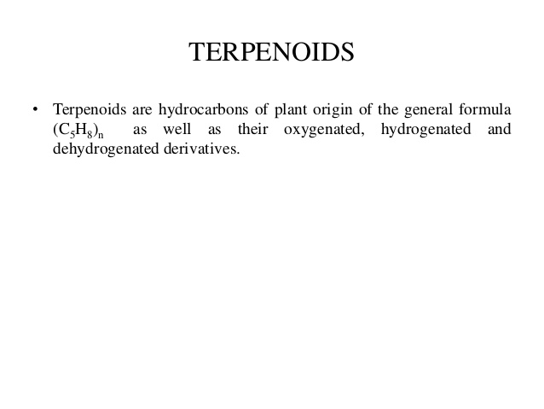

Slide 3
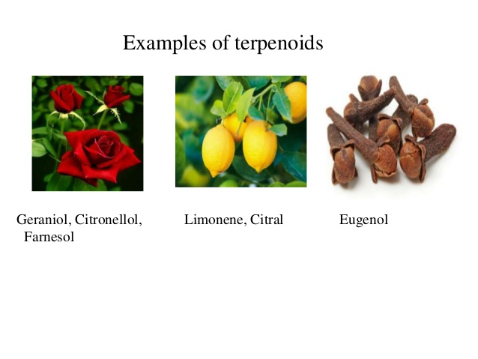

Slide 4
The terpenoids ,sometimes called isoprenoids, are a large and diverse class of naturally occurring organic chemicals derived from terpenes.About 60% of known natural products are terpenoids.
Essential oils:The essential oils are complex mixtures of hydrocarbons & their oxygenated derivatives. Among the chief constituents of the essential oils are the terpenoids having carbon atoms upto C15 and their oxygenated derivatives Such as alcohols, aldehydes & ketones.

Slide 5
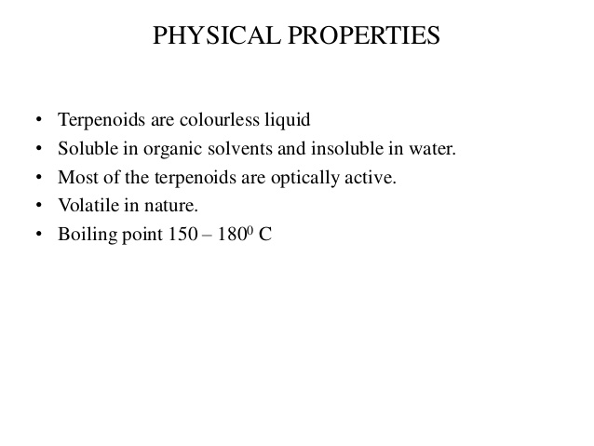

Slide 6
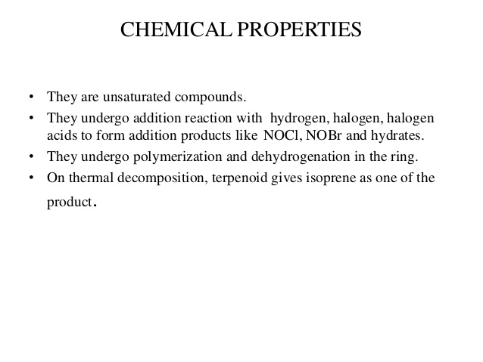

Slide 7
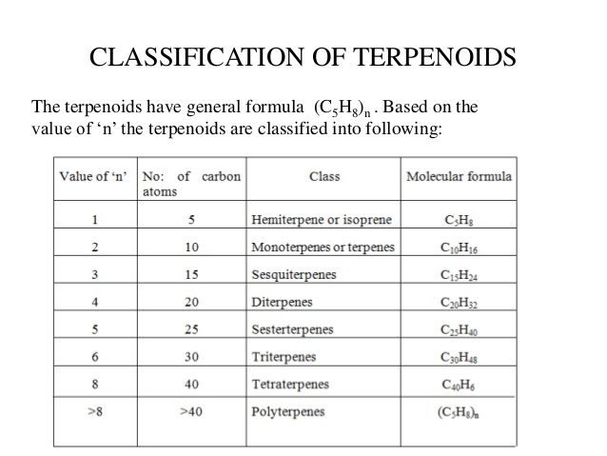
Classification: Terpinoid hydrocarbons are classified on the basis of the no of isoprene units which they contain.

Slide 8
Isolation of terpinoids
1)Isolation of essential oils from plan parts a)steam distillation method b)Solvent extraction c)Expression method d)Adsorption in purified fats(enfleurage)
2)separation of terpinoids from essential oils a)chemical method b)physical method

Slide 9
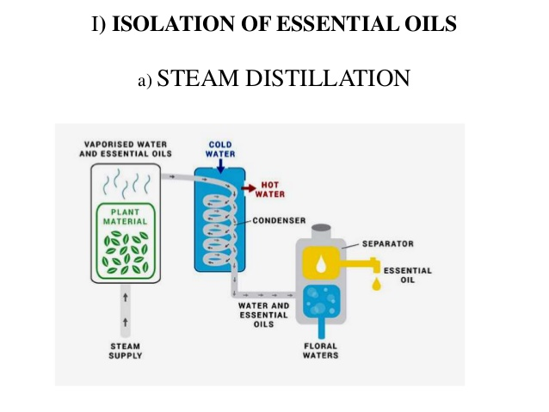

Slide 10
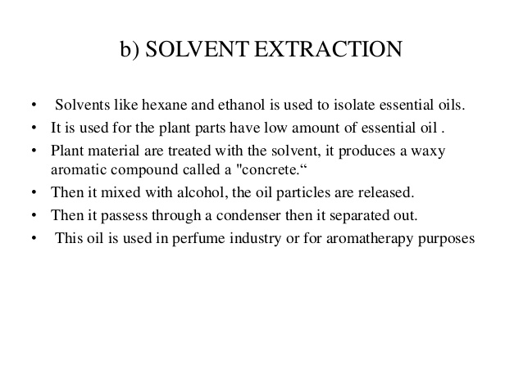

Slide 11
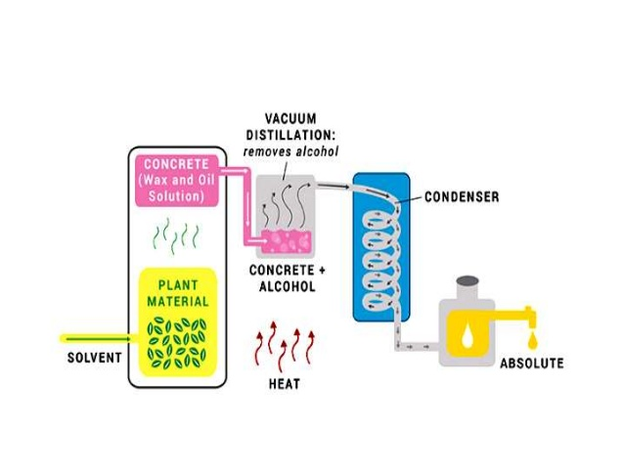

Slide 12
c)Expression method
The plant material is crushed and the juice is screened to remove the large particles.The screened juice is centrifuged in a high speed centrifugal machine when nearly half of the essential oil is extracted.

Slide 13
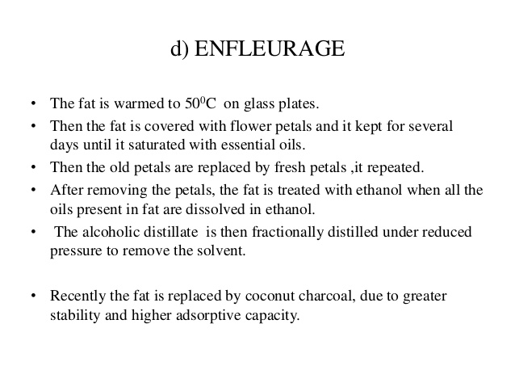

Slide 14
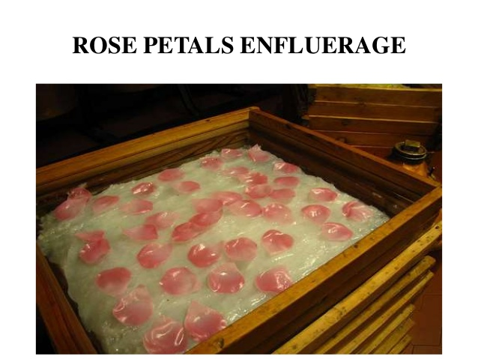

Slide 15
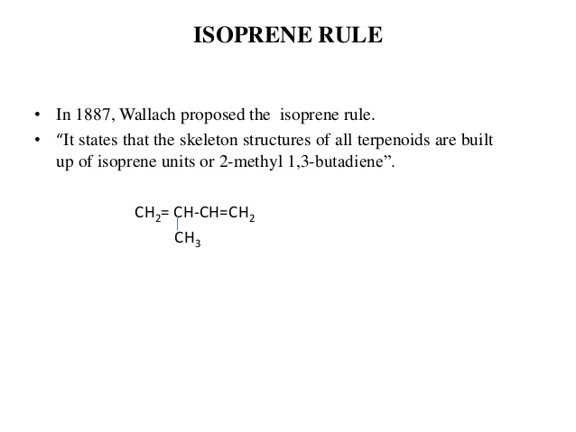

Slide 16
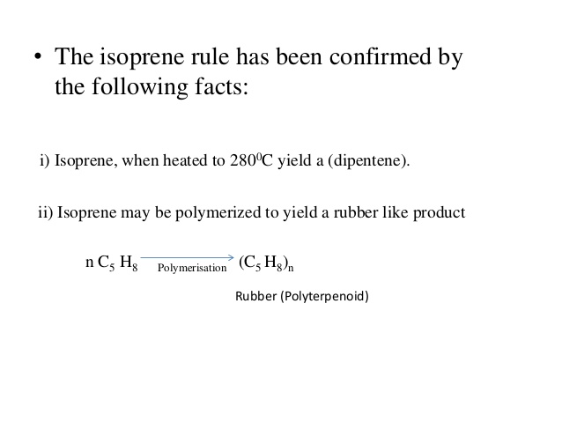

Slide 17
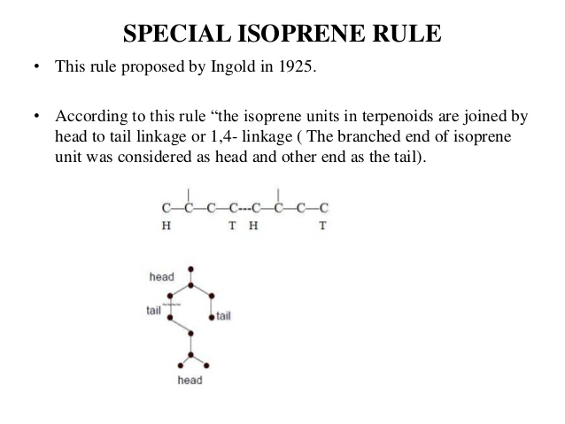

Slide 18
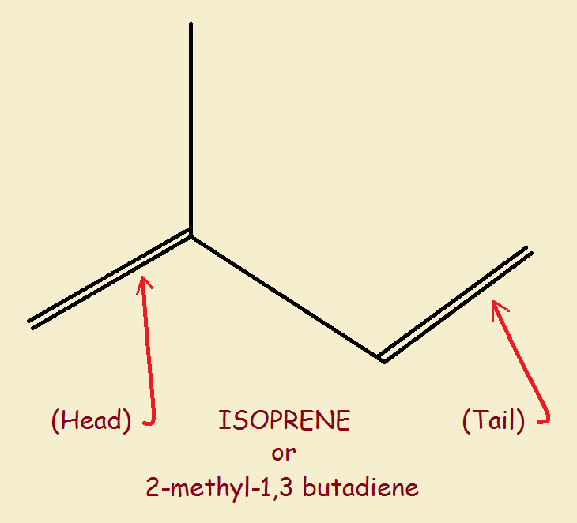

Slide 19
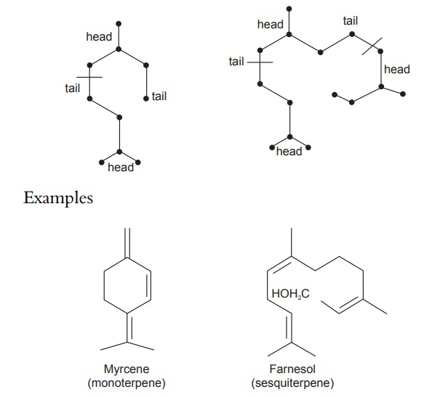

Slide 20
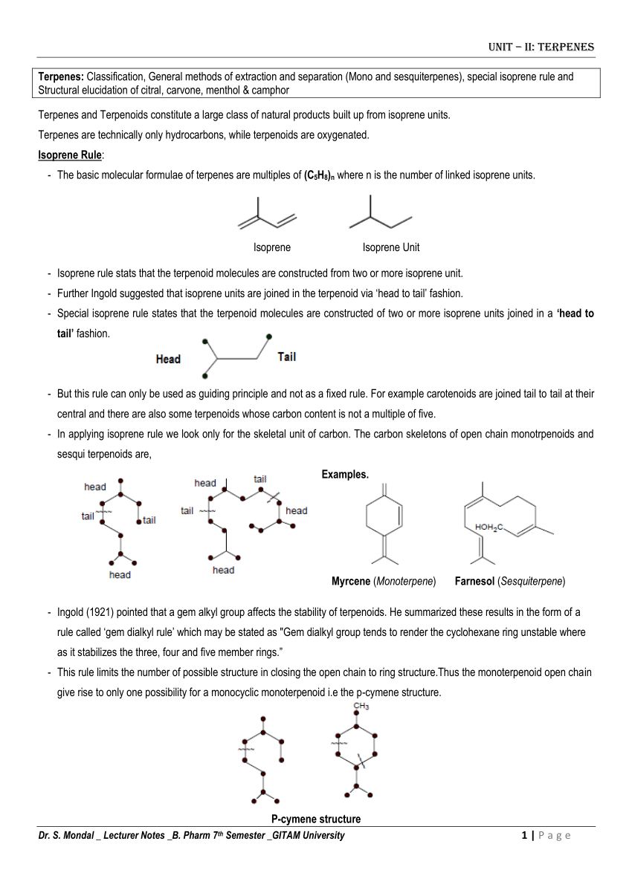

Slide 21
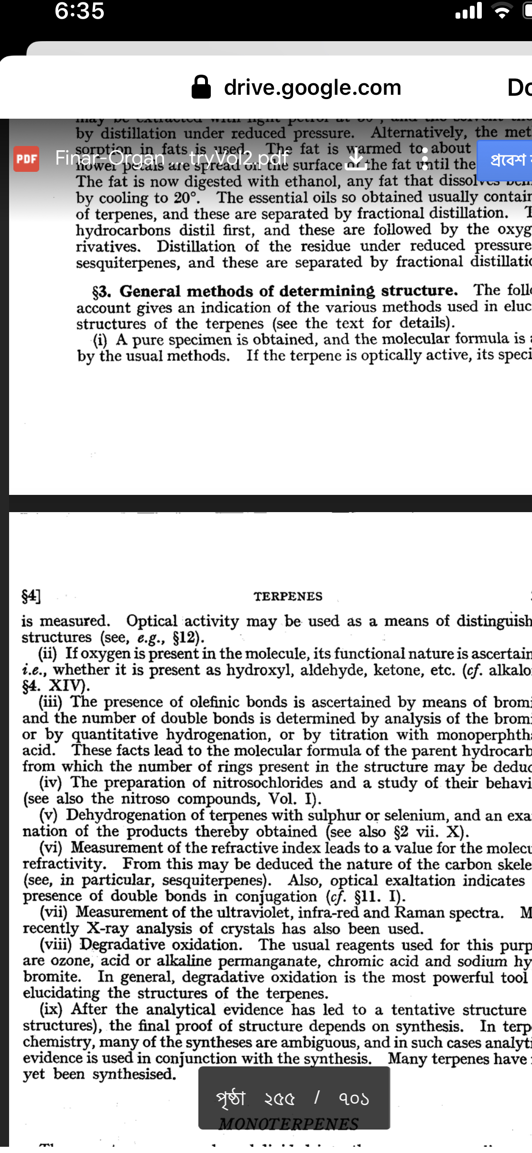

Slide 22
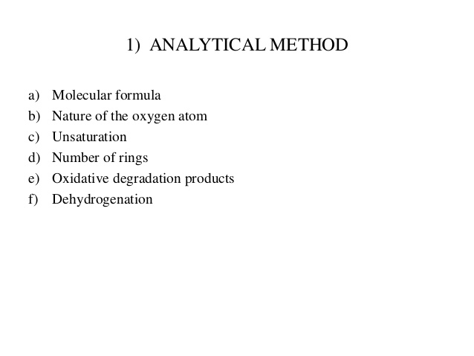

Slide 24
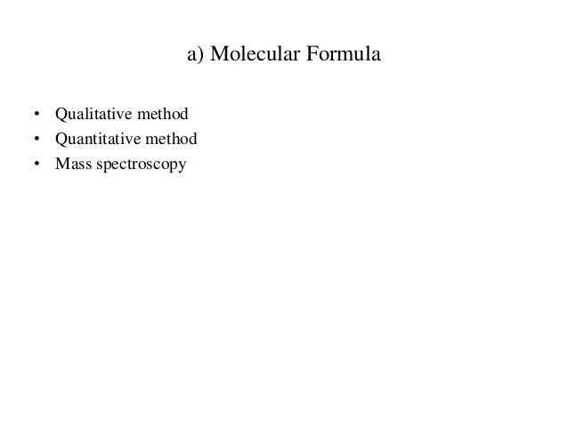
4

Slide 25
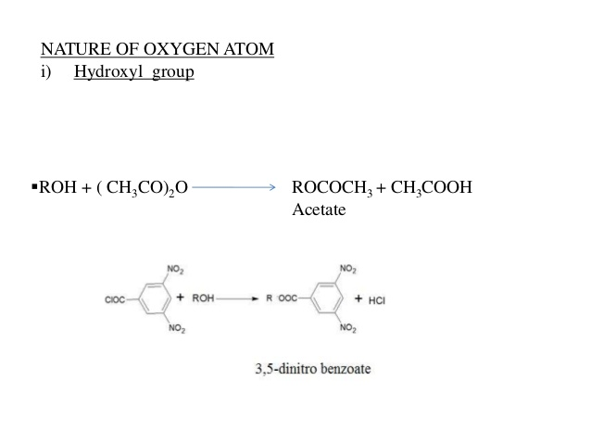

Slide 26
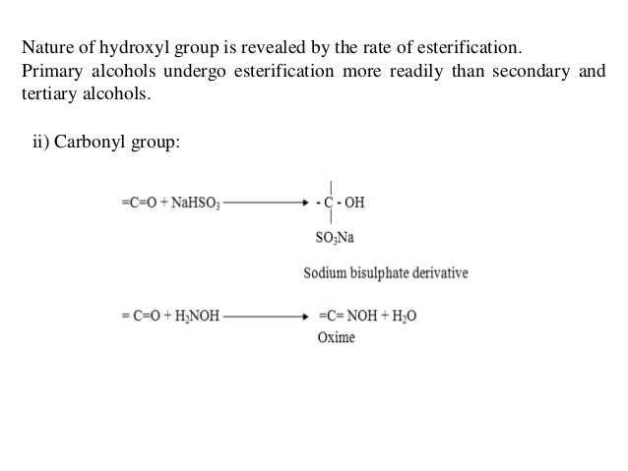

Slide 27
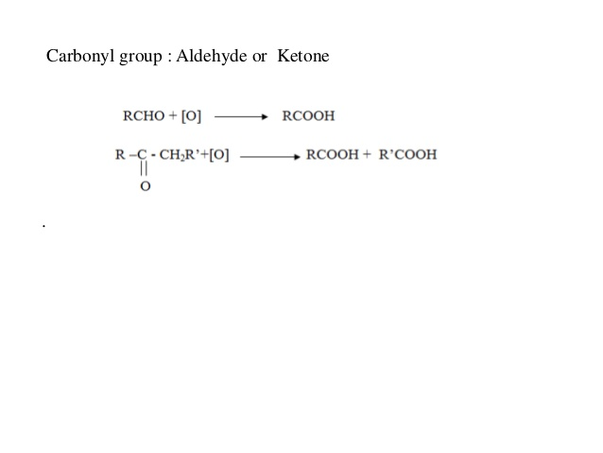

Slide 28
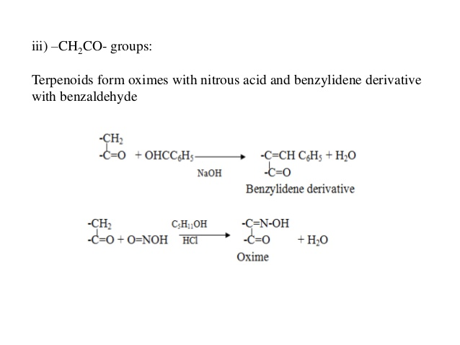

Slide 29
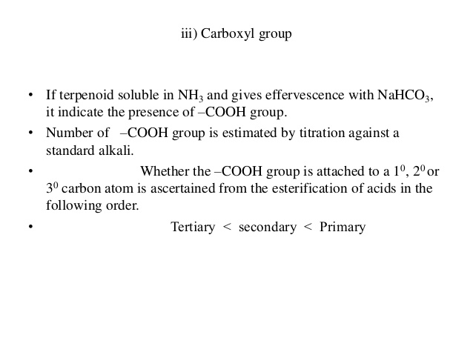

Slide 30
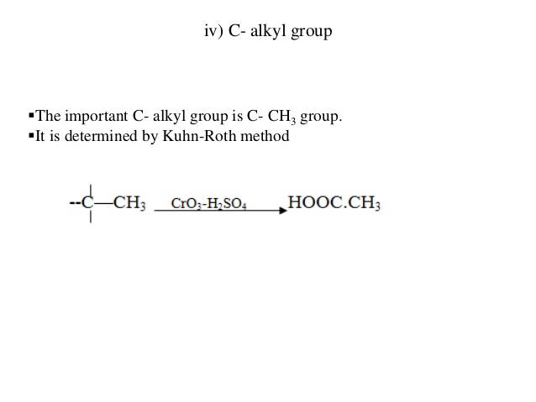

Slide 31
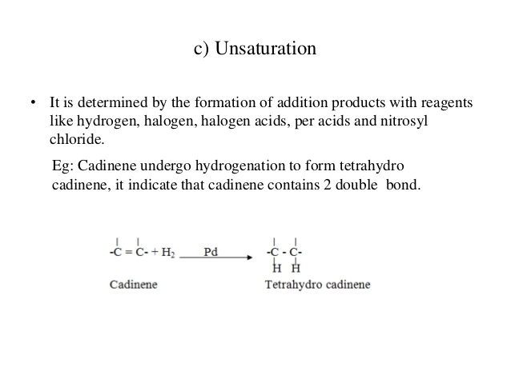

Slide 32
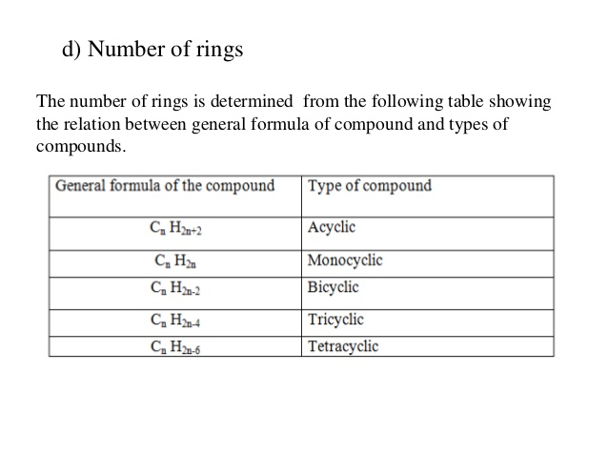

Slide 33
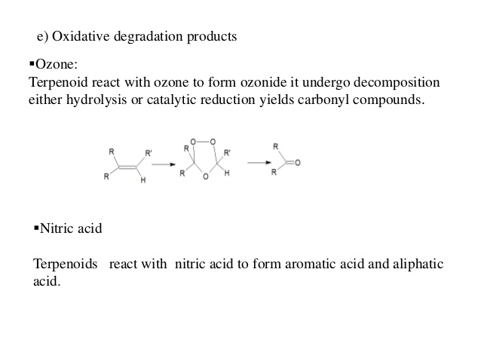

Slide 35
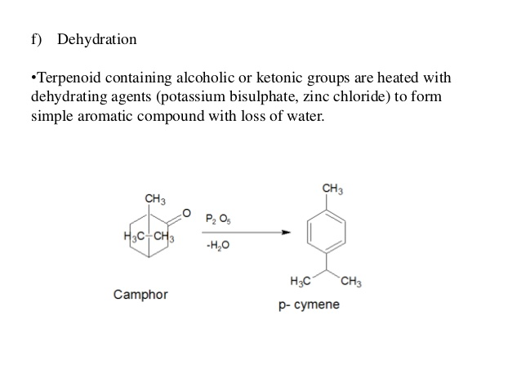

Slide 36
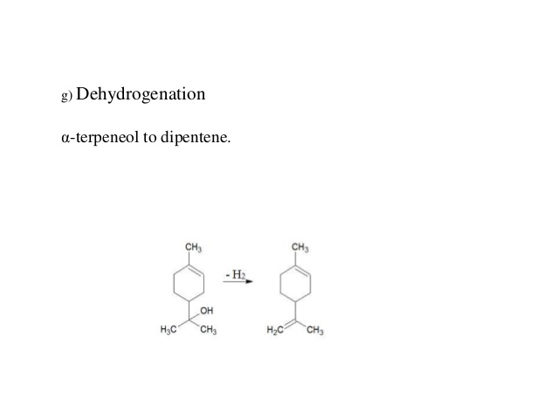

Slide 38
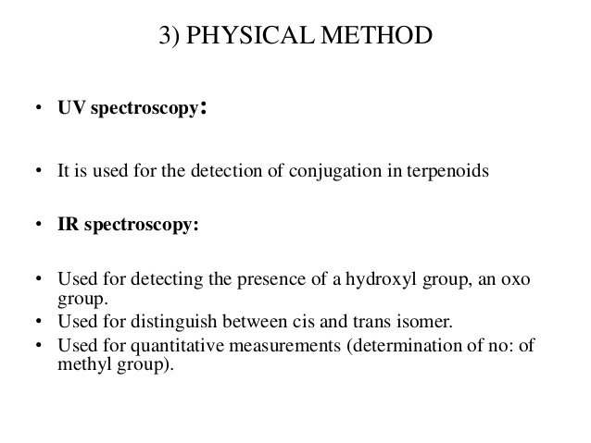

Slide 39
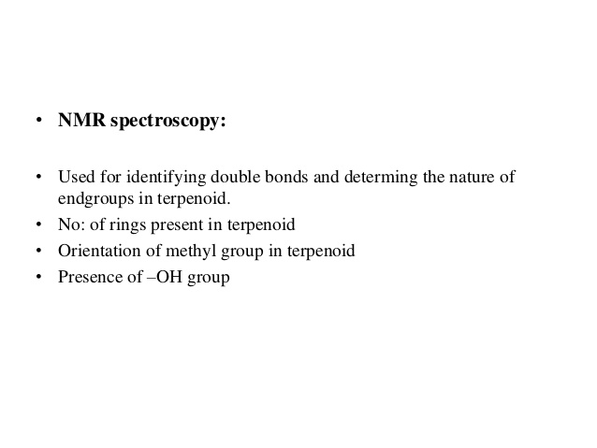

Slide 40
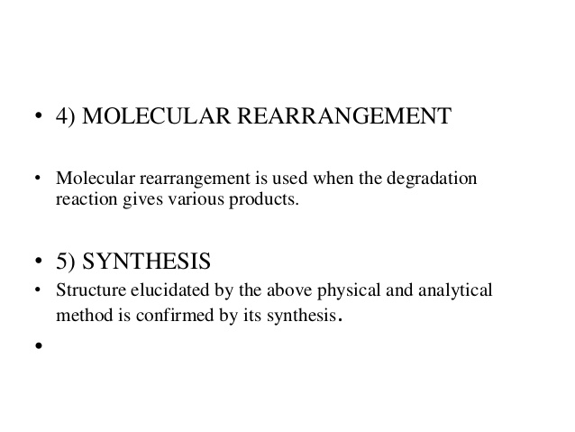

Slide 41
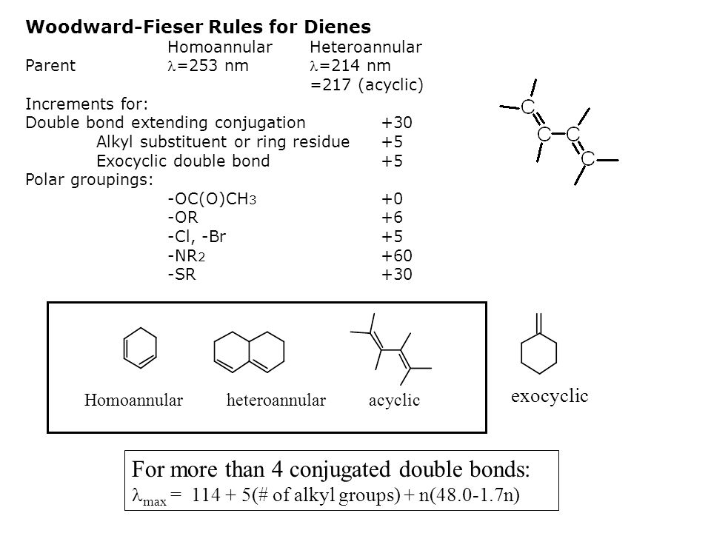

Slide 42
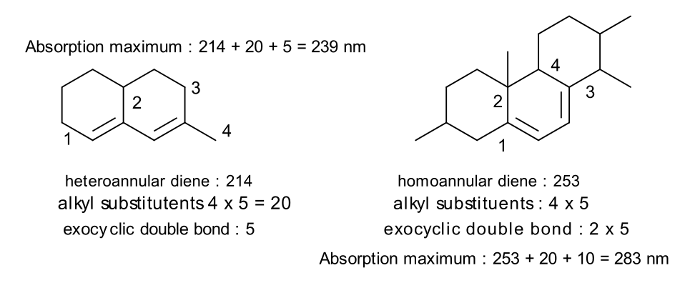

Slide 43
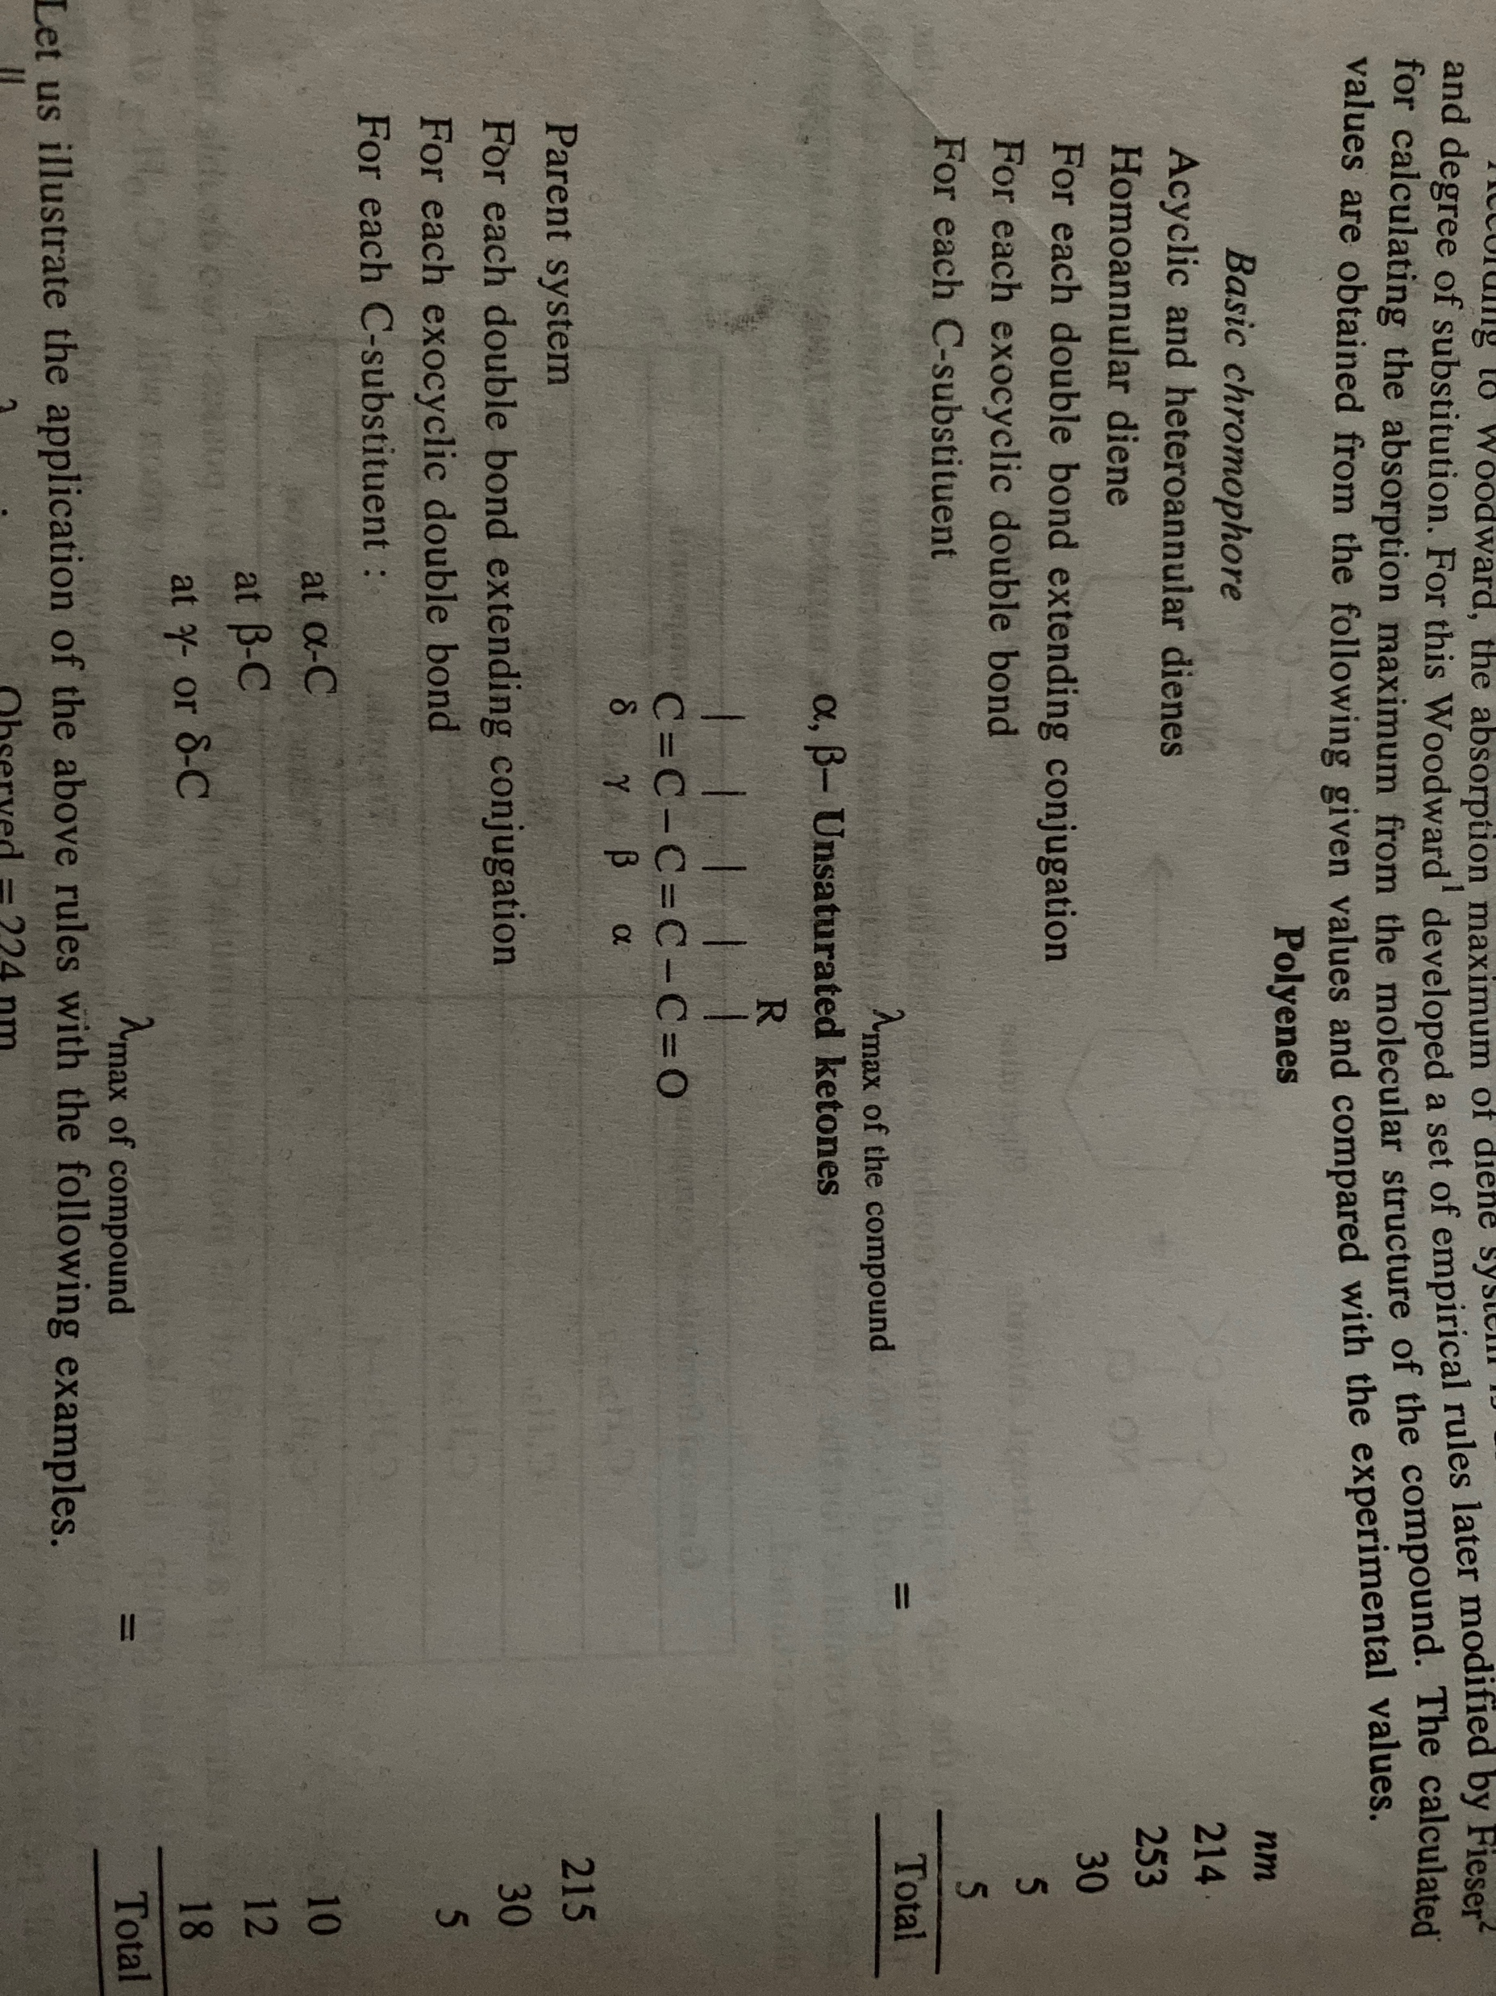

Slide 44
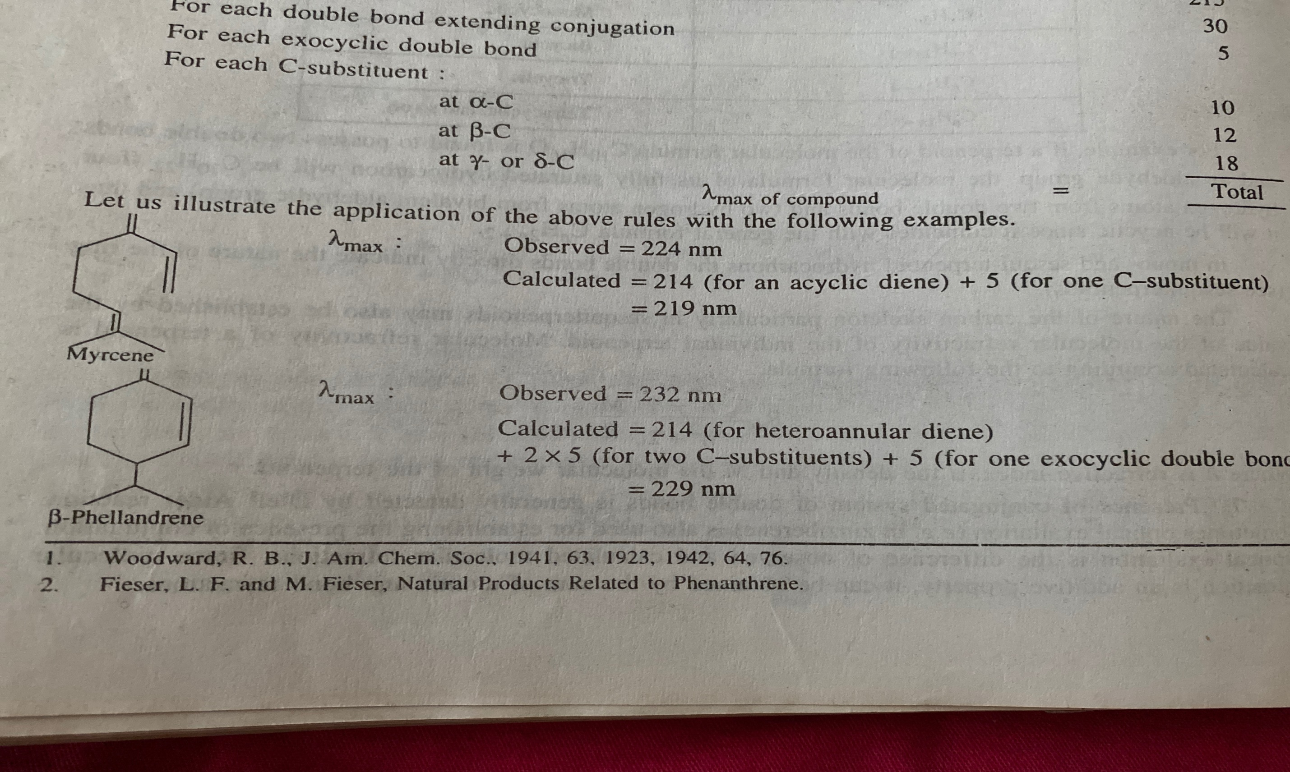

Slide 45
Absorption maximum of different compounds
LAcyclic diene – 217-228nm
Homoannular diene– 256-265nm
Heteroannular diene – 230-240nm
If alpha,bita unsaturated group is present -220-250nm

Slide 46
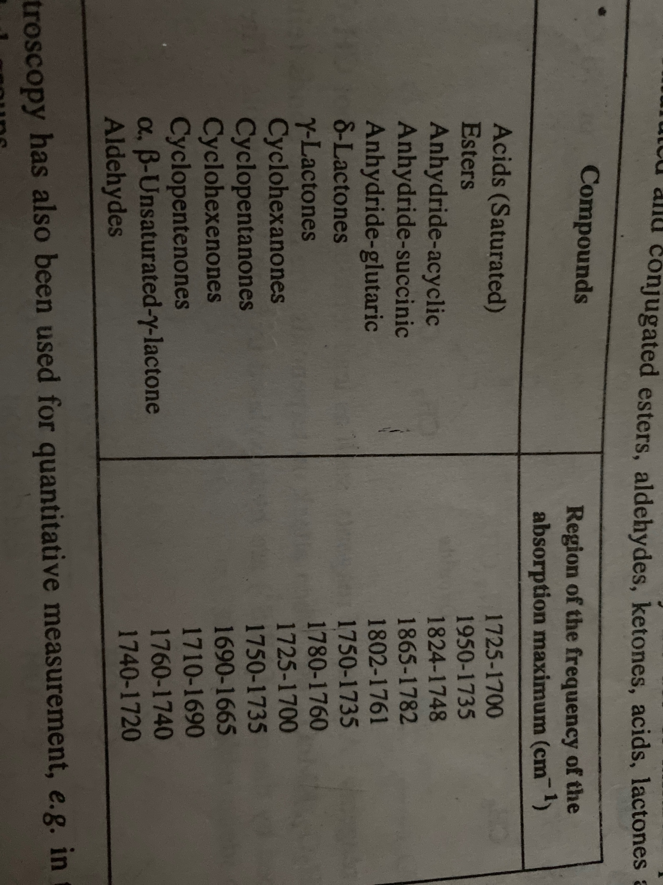
IR values of different compounds

Slide 47
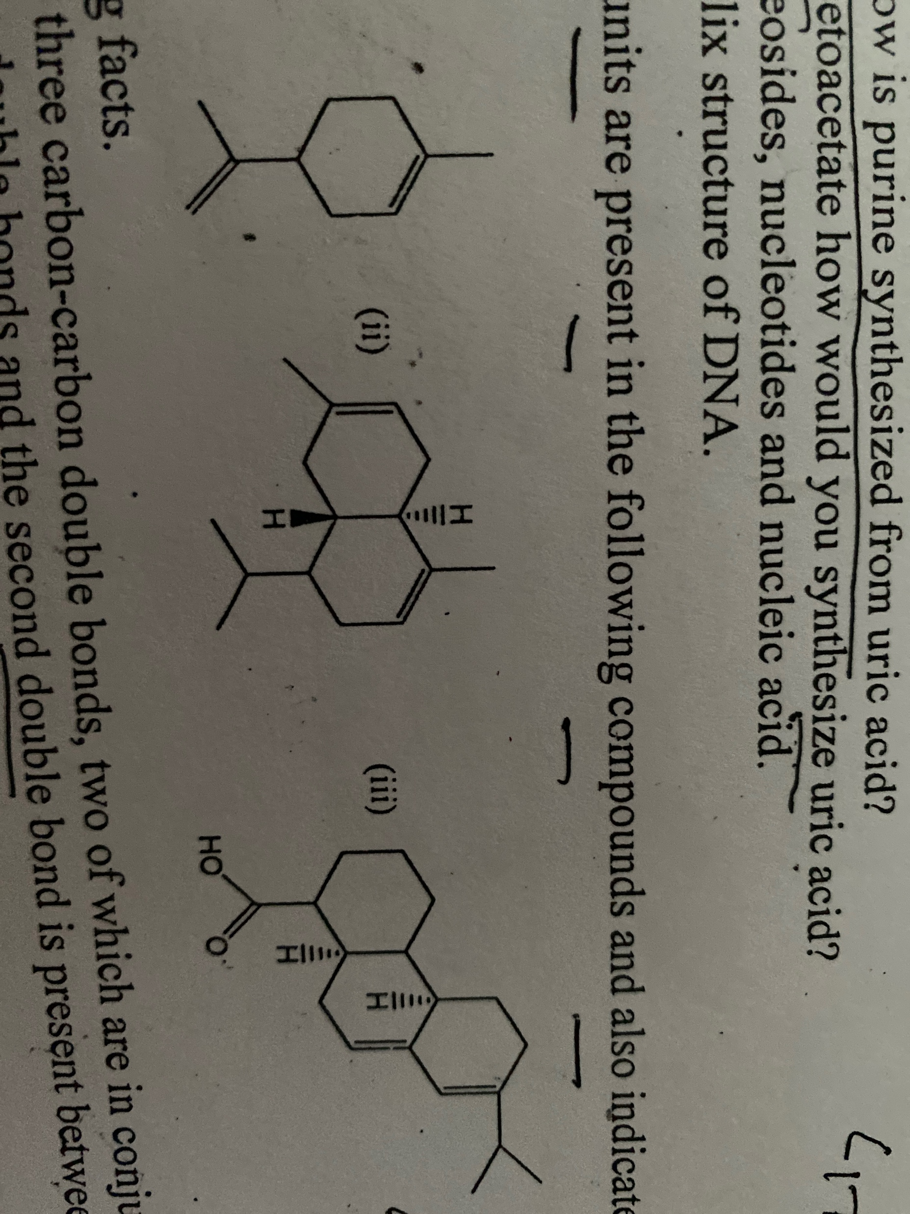
Homework:How many isoprene units are present in the following compounds and also indicate the head to tail fashion

Slide 48
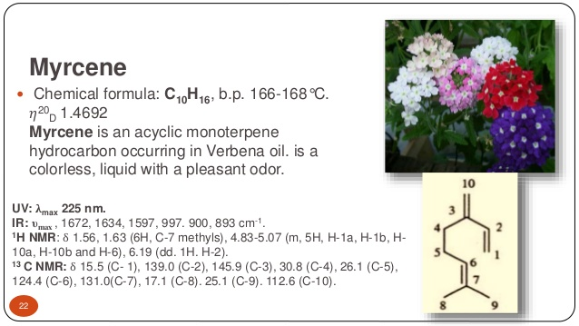

Slide 49
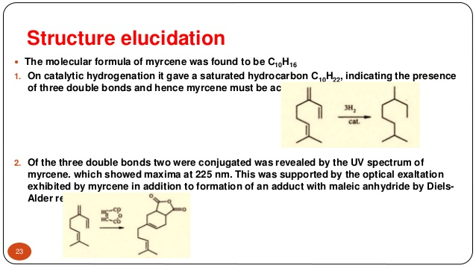

Slide 50
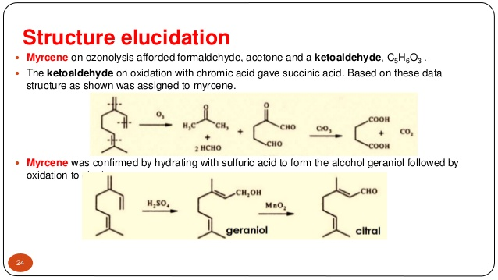

Slide 51
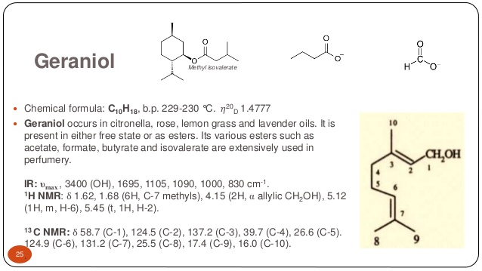

Slide 52
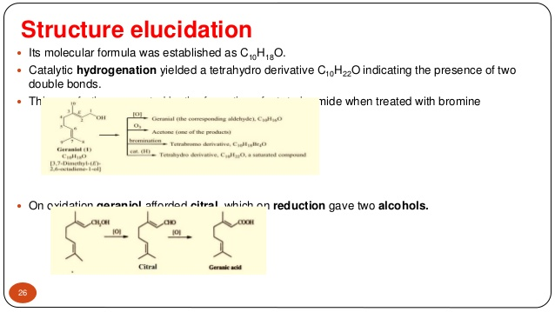

Slide 54
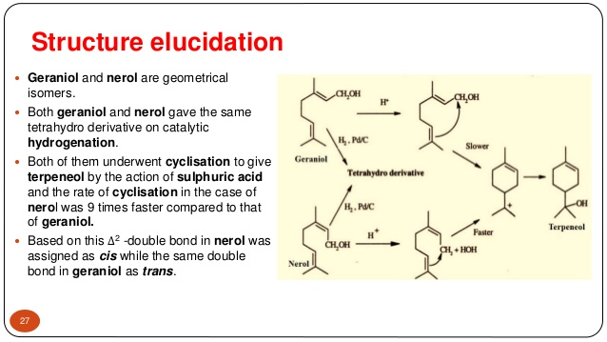

Slide 55
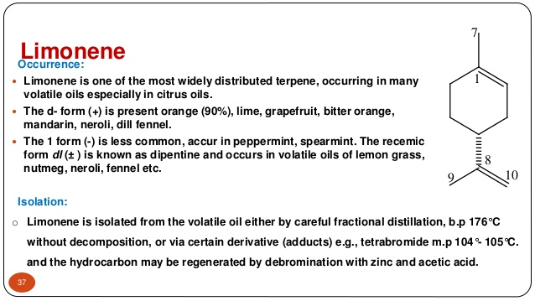

Slide 56
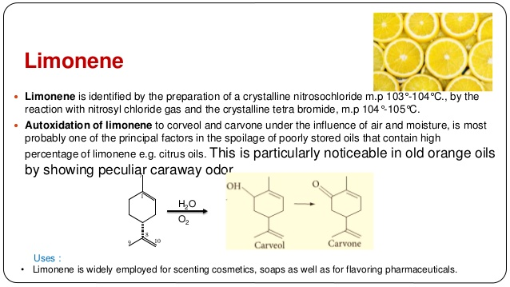

Slide 57
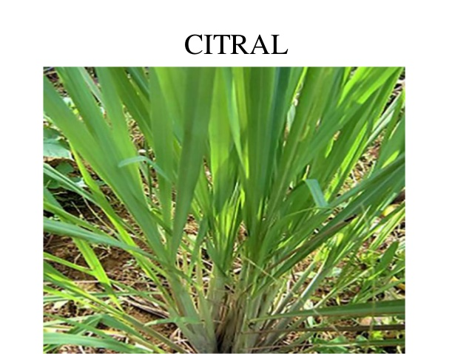

Slide 58
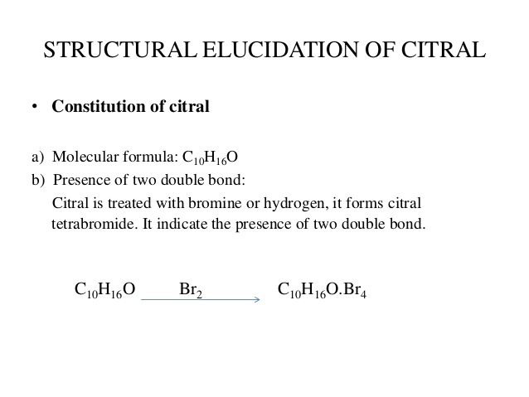

Slide 59
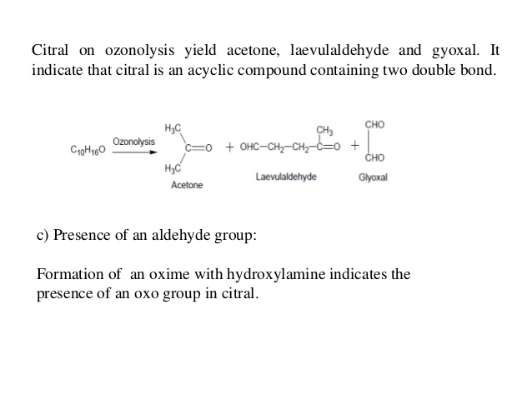

Slide 60


Slide 61


Slide 62


Slide 63


Slide 64


Slide 65


Slide 66
Homework :write the structure elucidation of farnesol. (Finar vol 2)

Slide 67
Biosynthesis of Terpenes:
Biosynthesis of terpenes may be studied in two parts:
(A) Synthesis of Activated 5-C units:
Isoprene unit is almost entirely synthesized from acetyl-CoA through mevalonic acid pathway as shown in Fig. 24.2 Three acetyl-CoA molecules are joined together in stepwise manner to from a six-carbon intermediate, mevalonic acid. Mevalonic acid is then pyrophosphorylated utilizing 2 ATP molecules to form mevalonic acid pyrophosphate (MVA- PP).
Decarboxylation and dehydration of MVA-PP result in the formation of activated 5-C unit called as isopentenyl pyrophosphate (IPP). The latter can be isomerized to another activated 5- C unit called as dimethylallyl pyrophosphate (DPP). Both these activated 5-C units are build­ing blocks of terpenes in plants.

Slide 68


Slide 69
B) Condensation of activated 5-C units IPP and DPP to form terpenes:
Terpenes are ultimately formed by condensation of activated 5-C units IPP and DPP as shown in Fig. 24.3. and briefly described below:
(i) IPP and DPP unite to form 10-C geranyl phyrophosphate (GPP) which is precursor of monoterpenes.

Slide 70
S:
(ii) GPP unites with another molecule of IPP to give rise to 15-C farnesyl pyrophosphate (FPP) which is precursor of sesquiterpenes.
(iii) FPP unites with IPP to form 20-C compound geranylgeranyl pyrophosphate (GGPP) which is precursor of diterpenes.

Slide 71

Synthesis of monoterpinoids from GPP

Slide 72

Polyterpenes are polymers containing large number of isopentenyl units.

Slide 74
Thank you

